Slide 1
Frequency of Solar Flares from 2012 to 2016. Micro-Project #1 https://github.com/JimboBoss87/ANA-500---AUG-2022
Demetri Papamichalis
08/10/2022

Slide 2
Problem Statement
A Solar flare is the rapid release of a large amount of electromagnetic energy energy stored in the solar atmosphere. Solar flares are thought to occur when stored magnetic energy in the Sun's atmosphere accelerates charged particles in the surrounding plasma.
During a flare, gas is heated to 10 to 20 million degrees Kelvin (K) and radiates soft X rays and longer-wavelength emission. Unable to penetrate the Earth's atmosphere, the X rays can only be detected from space.
Reuven Ramaty High Energy Solar Spectroscopic Imager (RHESSI) is a NASA solar flare observatory, in its 6th mission in the Small Explorer program Its primary goal is to explore the physics of particle acceleration, energy release in solar flares and frequency of those.
This new approach will enable researchers to find out where these particles are accelerated and to what energies. Such information will advance understanding of the fundamental high-energy processes at the core of the solar flare problem.
The only instrument on board is an imaging spectrometer with the ability to obtain high fidelity color movies of solar flares in X rays and gamma rays. It uses two new complementary technologies: fine grids to modulate the solar radiation, and germanium detectors to measure the energy of each photon very precisely.

Slide 3
Hypothesis Formulation
Ho: We hypothesize solar flares with high radiation energy output are mostly emitted from the
Sun’s equator region.

Slide 4
Acquire
For our data analysis we are using the data acquired from the 2012-2016 RHESSI Solar Flares Mission.
The dataset use is ‘hessi.solar.flare.2002to2016.csv’ from https://www.kaggle.com/datasets/khsamaha/solar-flares-rhessi
Dataset has 1113,942 records and 18 variables.

Slide 5
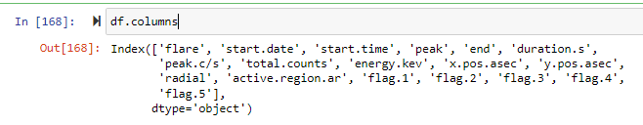
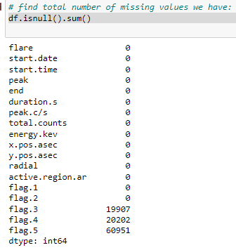
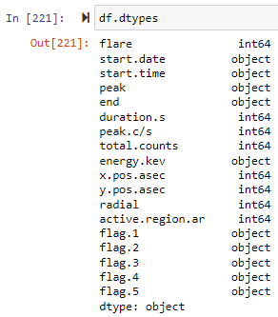
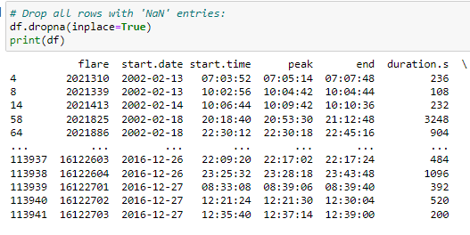
Prepare
1) read text file into pandas DataFrame in Python: 3) find any missing values:
2) Identify data types we have for each of our 18 variables:
4) drop all rows that have ‘NaN’ entries:

Slide 6
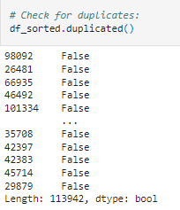
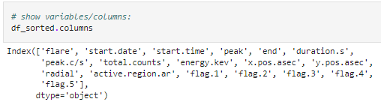
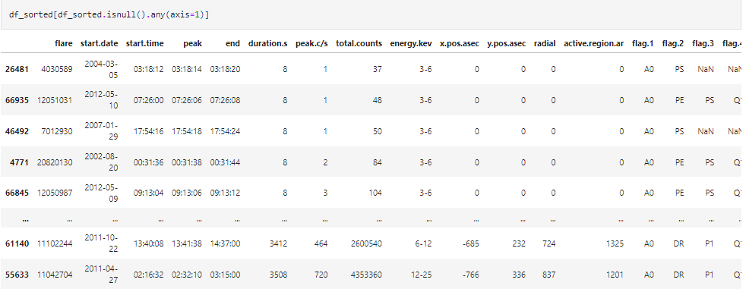
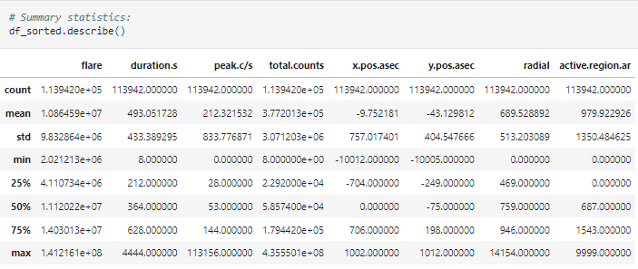
3) Show variables/columns: 5) Check for duplicates:
6) Summary statistics:
4) Sort data:

Slide 7
Analyze data
<select analytical technique, build models>

Slide 8
Report
<communicate results>

Slide 9
Act
<apply results, connect results with the chosen problem statement or business question>

